Slide 1
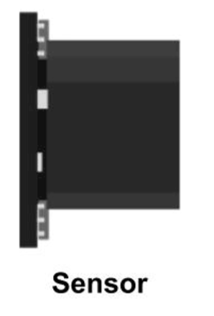

A
B
C
D
2 to 10 cm away
2+x to 10+x cm away
…
Tapping on red means you activate something like A[0];
Tapping on blue activate B[1].
Within each sensor you’ve got a range for different buttons.

